Slide 1
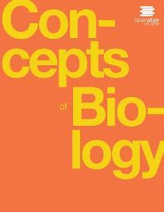
Concepts of Biology
Chapter 7 THE CELLULAR BASIS OF INHERITANCE
PowerPoint Image Slideshow

Slide 2
Introduction
All living things have the ability to reproduce in kind (in kind means that the offspring of any organism closely resembles its parent or parents)
Example: hippopotamuses give birth to hippopotamus calves; Monterey pine trees produce seeds that can produce Monterey pine tree
In kind does not mean exactly the same

Slide 3
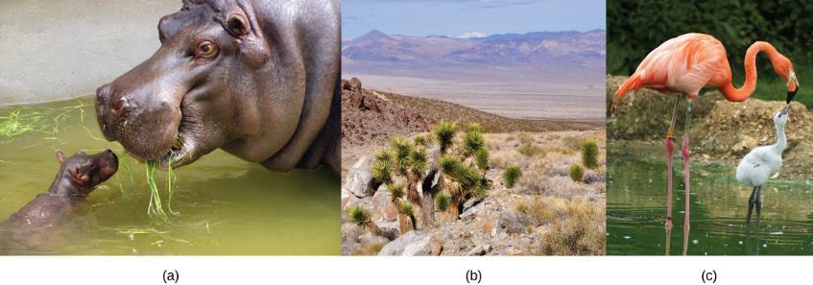
Figure 7.1
Each of us, like these other large multicellular organisms, begins life as a fertilized egg. After trillions of cell divisions, each of us develops into a complex, multicellular organism. (credit a: modification of work by Frank Wouters; credit b: modification of work by Ken Cole, USGS; credit c: modification of work by Martin Pettitt)
This OpenStax ancillary resource is © Rice University under a CC-BY 4.0 International license; it may be reproduced or modified but must be attributed to OpenStax, Rice University and any changes must be noted. Any images credited to other sources are similarly available for reproduction, but must be attributed to their sources.

Slide 4
7.1: Sexual Reproduction
Sexual reproduction has some advantages (like leads to evolution) and some disadvantages
Asexual reproduction also has it’s advantages including:
Identical to parent (if the parent is successful in a particular habitat, the offspring will be similarly successful)
Does not require a member of the opposite sex (don’t expend energy finding a mate, that energy can be used to produce more offspring)
Asexual organisms only have females, so all member of the population can reproduce (so populations can grow twice as fast)

Slide 5
Life Cycles of Sexually Reproducing Organisms (1 of 6)
Life cycles – the sequence of events in the development of an organism and the production of cells that produce offspring
Fertilization and meiosis alternate in sexual life cycles
The process of meiosis reduces the resulting gamete’s chromosome number by half
Fertilization – the joining of two haploid gametes, restores the diploid condition

Slide 6
Life Cycles of Sexually Reproducing Organisms (2 of 6)
There are 3 main categories of life cycles in multicellular organisms:
Diploid-dominant – the multicellular diploid stage is the most obvious life stage (humans are in this category)
Haploid-dominant – the multicellular haploid stage is the obvious life stage (all fungi and some algae are in this category)
Alternation of generations – the two stages, haploid and diploid, are apparent to one degree or another depending on the group (plants and some algae are in this category)

Slide 7
Life Cycles of Sexually Reproducing Organisms (3 of 6)
Nearly all animals employ a diploid-dominant life-cycle strategy in which the only haploid cells produced by the organism are the gametes
Gametes are produced from diploid germ cells, a special cell line that only produces gametes
Gametes are haploid and unable to divide again, there is no multicellular haploid life stage
Fertilization, the fusion of the two gamete restores the diploid stage

Slide 8
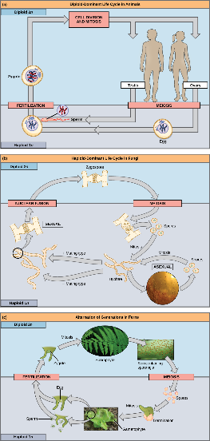
Figure 7.2
In animals, sexually reproducing adults form haploid gametes from diploid germ cells.
Fungi, such as black bread mold (Rhizopus nigricans), have haploid-dominant life cycles.
Plants have a life cycle that alternates between a multicellular haploid organism and a multicellular diploid organism. (credit c “fern”: modification of work by Cory Zanker; credit c “gametophyte”: modification of work by “Vlmastra”/Wikimedia Commons)
This OpenStax ancillary resource is © Rice University under a CC-BY 4.0 International license; it may be reproduced or modified but must be attributed to OpenStax, Rice University and any changes must be noted. Any images credited to other sources are similarly available for reproduction, but must be attributed to their sources.

Slide 9
Life Cycles of Sexually Reproducing Organisms (4 of 6)
Most fungi and algae employ a life-cycle strategy in which the multicellular “body” of the organism is haploid
During sexual reproduction, specialized haploid cells from two individuals join to form a diploid zygote
The zygote immediately undergoes meiosis to form four haploid cells called spores

Slide 10
Life Cycles of Sexually Reproducing Organisms (5 of 6)
All plants and some algae employ the alternation of generations type of life cycle
The haploid multicellular plants are called gametophytes because they produce gametes (meiosis is not involved in this production of gametes because the organism in already haploid)

Slide 11
Life Cycles of Sexually Reproducing Organisms (6 of 6)
Fertilization between the gametes forms a diploid zygote, the zygote undergoes many rounds of mitosis to give rise the a diploid multicellular plant called a sporophyte
Specialized cells of the sporophyte will undergo meiosis to produce haploid spores, these spores will develop into gametophytes

Slide 12
7.2: Meiosis (1 of 4)
Sexual reproduction requires fertilization - a union of two cells from two individual organisms
The number of sets of chromosomes in a cell is called its ploidy level: haploid cells contain one set of chromosomes; diploid cells contain two sets of chromosomes.
Sexually reproduction requires reduction of chromosome count before fertilization can occur, this is known as meiosis

Slide 13
7.2: Meiosis (2 of 4)
Most animals and plants are diploid; in each somatic cell (the nonreproductive cells of a multicellular organism), the nucleus contains two copies of each chromosome that are referred to as homologous chromosomes
Somatic cells are sometimes referred to as “body” cells
Homologous chromosomes are matched pairs containing genes for the same traits in identical locations along their length
Diploid organisms inherit one copy of each homologous chromosome from each parent

Slide 14
7.2: Meiosis (3 of 4)
The nuclear division that forms haploid cells, which is called meiosis, employs many of the same mechanisms as mitosis
The starting nucleus is always diploid (as it is in mitosis) and the nuclei that result at the end of a meiotic cell division are haploid (different than the diploid end result of mitosis)
To achieve this reduction, meiosis consists of one round of duplication, and two rounds of nuclear division

Slide 15
7.2: Meiosis (4 of 4)
The same stage names are assigned that were assigned to mitosis; however the two rounds of division are designated by “I” and “II”
Meiosis I (consisting of prophase I, prometaphase I, etc.) and meiosis II (consisting of prophase II, prometaphase II, etc)

Slide 16
Interphase
Meiosis is preceded by an interphase consisting of the G₁, S, and G₂ phases, which are nearly identical to the phases preceding mitosis
The G₁ phase is the first phase of interphase and is focused on cell growth
The S phase is when the DNA of the chromosomes is replicated (each chromosome is then composed of two identical copies called sister chromatids)
The G₂ phase the cell undergoes the final preparations for meiosis

Slide 17
Meiosis I (1 of 7)
Prophase I – chromosomes can be seen clearly microscopically.
Nuclear envelopes begins to break down and homologous chromosomes are paired tightly, called synapsis
In synapsis, the genes of the chromatids of the homologous chromosomes are precisely aligned with each other and crossing over occurs (the exchange of chromosome segments between non-sister homologous chromatids)
This process is revealed visually after the exchange as chiasmata (singular= chiasma)

Slide 18
Meiosis I (2 of 7)
During prophase I, the four sister chromatids of each pair of homologous chromosome are called tetrads
Crossover events are the first source of genetic variation produced by meiosis
After crossover occurs, the recombinant sister chromatid has a combination of maternal and paternal genes that did not exist before the crossover

Slide 19
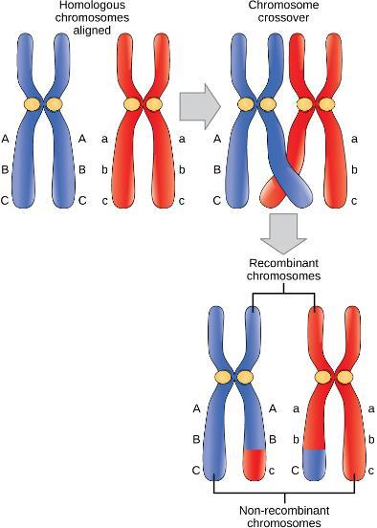
Figure 7.3
In this illustration of the effects of crossing over, the blue chromosome came from the individual’s father and the red chromosome came from the individual’s mother. Crossover occurs between non-sister chromatids of homologous chromosomes. The result is an exchange of genetic material between homologous chromosomes. The chromosomes that have a mixture of maternal and paternal sequence are called recombinant and the chromosomes that are completely paternal or maternal are called non-recombinant.
This OpenStax ancillary resource is © Rice University under a CC-BY 4.0 International license; it may be reproduced or modified but must be attributed to OpenStax, Rice University and any changes must be noted. Any images credited to other sources are similarly available for reproduction, but must be attributed to their sources.

Slide 20
Meiosis I (3 of 7)
Prometaphase I – the key event is the attachment of the spindle fiber microtubules to the kinetochore proteins at the centromere

Slide 21
Meiosis I (4 of 7)
Metaphase I – the homologous chromosomes are randomly arranged in the center of the cell
This is called independent assortment and is another source of genetic variations
There are two possibilities for orientation and humans have 23 pairs of chromosomes, so for humans the number of possible combinations of arrangements at the midline of the cell is equal to 2²³ or over 8 million possibilities; therefore, it is HIGHLY unlikely that any two haploid cells resulting from meiosis will have the same genetic composition

Slide 22
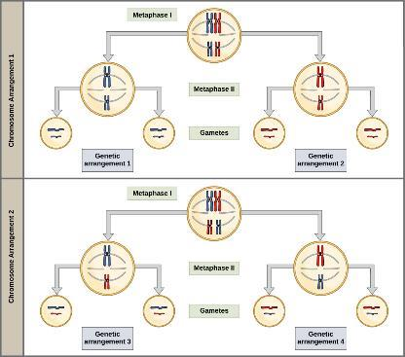
Figure 7.4
To demonstrate random, independent assortment at metaphase I, consider a cell with n = 2. In this case, there are two possible arrangements at the equatorial plane in metaphase I, as shown in the upper cell of each panel. These two possible orientations lead to the production of genetically different gametes. With more chromosomes, the number of possible arrangements increases dramatically.
This OpenStax ancillary resource is © Rice University under a CC-BY 4.0 International license; it may be reproduced or modified but must be attributed to OpenStax, Rice University and any changes must be noted. Any images credited to other sources are similarly available for reproduction, but must be attributed to their sources.

Slide 23
Meiosis I (5 of 7)
Anaphase I – the spindle fibers pull the linked chromosomes apart
Sister chromatids remain attached at the centromeres

Slide 24
Meiosis I (6 of 7)
Telophase I – the separated chromosomes arrive at opposite poles
In some organisms, the chromosomes decondense and nuclear envelopes form around the chromatids

Slide 25
Meiosis I (7 of 7)
Cytokinesis – the physical separation of the cytoplasmic components into two daughter cells
Cytokinesis either occurs by cleavage furrow (in animals and some fungi) or by formation of the cell plate (in plants)
Cells are now considered haploid because they contain only one member of the homologous pair, even though it is still pair with the sister chromatid which is no longer identical because crossover occurred

Slide 26
Visit this interactive website:
http://openstaxcollege.org/l/animal_meiosis2

Slide 27
Meiosis II (2 of 3)
In meiosis II, the connected sister chromatids remaining in the haploid cells from meiosis I will split to form four haploid cells
In some species, cells enter a brief interphase or interkinesis that lacks the S phase before entering into meiosis II
Overall, meiosis II resembles mitotic division except it is occurring in haploid cells

Slide 28
Meiosis II (1 of 3)
Prophase II – chromosome condense again (if they decondensed), nuclear envelope fragment (if they reformed), centrosomes move to opposite poles and new spindles are formed
Prometaphase II – each sister chromatid attached to microtubules (spindles) from opposite poles
Metaphase II – sister chromatids align at the center of the cell
Anaphase II – sister chromatids are pulled apart by the spindle fibers and move toward opposite poles

Slide 29
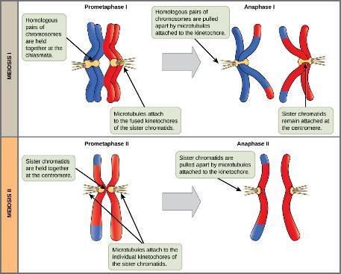
Figure 7.5
In prometaphase I, microtubules attach to the fused kinetochores of homologous chromosomes. In anaphase I, the homologous chromosomes are separated. In prometaphase II, microtubules attach to individual kinetochores of sister chromatids. In anaphase II, the sister chromatids are separated.
This OpenStax ancillary resource is © Rice University under a CC-BY 4.0 International license; it may be reproduced or modified but must be attributed to OpenStax, Rice University and any changes must be noted. Any images credited to other sources are similarly available for reproduction, but must be attributed to their sources.

Slide 30
Meiosis II (3 of 3)
Telophase II – chromosomes arrive at opposite poles and begin to decondense
Nuclear envelopes form around the chromosomes
Cytokinesis separates the two cells into four genetically unique haploid cells
Cells are genetically unique because of the random assortment of paternal and maternal homologs and because of the recombination of maternal and paternal segments of chromosomes that occurs during crossover

Slide 31
Comparing Meiosis and Mitosis
Mitosis and Meiosis (which are both forms of nuclear division in eukaryotes), share some similarities, but also exhibit distinct differences that lead to their very different outcomes
Mitosis –
One nuclear division
Creates two daughter cells
Create genetically identical cells
Daughter cells are diploid
Meiosis –
Two nuclear divisions
Creates four daughter cells
Creates genetically unique daughter cells
Daughter cells are haploid

Slide 32
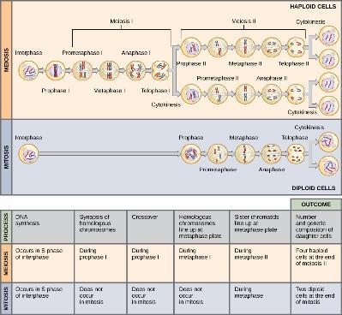
Figure 7.6
Meiosis and mitosis are both preceded by one round of DNA replication; however, meiosis includes two nuclear divisions. The four daughter cells resulting from meiosis are haploid and genetically distinct. The daughter cells resulting from mitosis are diploid and identical to the parent cell.
This OpenStax ancillary resource is © Rice University under a CC-BY 4.0 International license; it may be reproduced or modified but must be attributed to OpenStax, Rice University and any changes must be noted. Any images credited to other sources are similarly available for reproduction, but must be attributed to their sources.

Slide 33
Visit this interactive website:
http://openstaxcollege.org/l/how_cells_dvid2

Slide 34
7.3 Errors in meiosis
Inherited disorders can arise when chromosomes behave abnormally during meiosis
Chromosome disorders can be divided into two categories:
Abnormalities in chromosome number
Chromosome structural rearrangements
Because even small segments of chromosomes can span many genes, chromosomal disorders are characteristically dramatic and often fatal

Slide 35
Disorders in Chromosome Number
Karyotype - the number and appearance of chromosomes, including their length, banding pattern, and centromere position
To obtain a view of an individual’s karyotype, cytologists photograph the chromosomes and then cut and paste each chromosome into a chart, or karyogram

Slide 36
Figure 7.7
This karyogram shows the chromosomes of a female human immune cell during mitosis. (credit: Andreas Bolzer, et al)
This OpenStax ancillary resource is © Rice University under a CC-BY 4.0 International license; it may be reproduced or modified but must be attributed to OpenStax, Rice University and any changes must be noted. Any images credited to other sources are similarly available for reproduction, but must be attributed to their sources.

Slide 37
Nondisjunctions, Duplications, and Deletions
(1 of 9)
Abnormalities in chromosome number are the most easily identifiable chromosomal disorders
They include duplication or loss or entire chromosomes, as well as changes in the number of complete sets of chromosomes

Slide 38
Nondisjunctions, Duplications, and Deletions
(2 of 9)
They are caused by nondisjunction, which occurs when pairs of homologous chromosomes or sister chromatids fail to separate during meiosis
The risk of nondisjunction increases with the age of the parents
Nondisjunction can occur during meiosis I or II, with different results

Slide 39
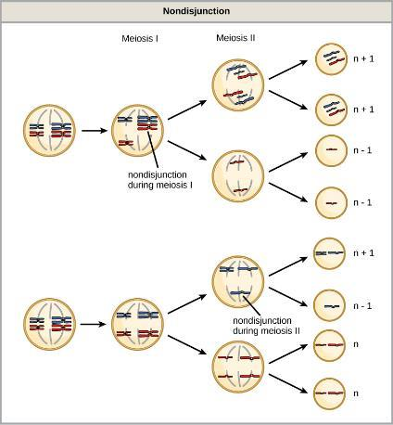
Figure 7.8
Following meiosis, each gamete has one copy of each chromosome. Nondisjunction occurs when homologous chromosomes (meiosis I) or sister chromatids (meiosis II) fail to separate during meiosis.
This OpenStax ancillary resource is © Rice University under a CC-BY 4.0 International license; it may be reproduced or modified but must be attributed to OpenStax, Rice University and any changes must be noted. Any images credited to other sources are similarly available for reproduction, but must be attributed to their sources.

Slide 40
Nondisjunctions, Duplications, and Deletions
(3 of 9)
Euploid – an individual with the appropriate number of chromosomes
In humans, euploidy corresponds to 22 pairs of autosomes, and one pair of sex chromosomes

Slide 41
Nondisjunctions, Duplications, and Deletions
(4 of 9)
Aneuploid – an individual with an error in chromosome number
Monosomy – loss of one chromosome
Autosomal monosomies fail to develop to birth
Trisomy – gain of an extraneous chromosome
Most autosomal trisomies fail to develop to birth; however duplications of chromosomes 13, 15, 18, 21, or 22 can result in offspring that survive for several weeks to many years
Trisomy 21 is the most common and leads to Down’s Syndrome

Slide 42
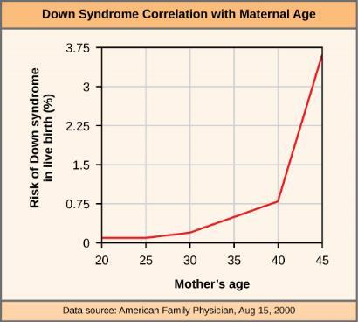
Figure 7.9
The incidence of having a fetus with trisomy 21 increases dramatically with maternal age.
This OpenStax ancillary resource is © Rice University under a CC-BY 4.0 International license; it may be reproduced or modified but must be attributed to OpenStax, Rice University and any changes must be noted. Any images credited to other sources are similarly available for reproduction, but must be attributed to their sources.

Slide 43
Nondisjunctions, Duplications, and Deletions
(5 of 9)
How can males and females both function normally despite the fact that they carry different numbers of the X chromosome?
In part, because of a process called X inactivation
In early development, one of a female’s X chromosomes in each cell inactivates by condensing into a structure called a Barr body
The genes on the Barr body are not expressed, which compensates for the females’ double genetic dose of X chromosome

Slide 44
Nondisjunctions, Duplications, and Deletions
(6 of 9)
In “tortoiseshell” cats, the color coat gene is an X-linked gene
Different coat colors will be expressed over different regions of their body, corresponding to whichever X chromosome is inactivated
Because of this, when you see a tortoiseshell cat, you will know that is has to be a female

Slide 45
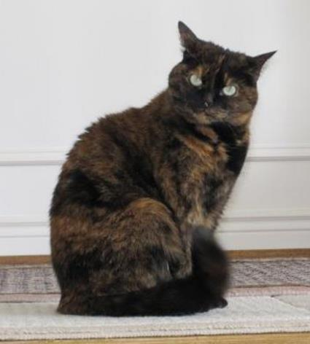
Figure 7.10
Embryonic inactivation of one of two different X chromosomes encoding different coat colors gives rise to the tortoiseshell phenotype in cats. (credit: Michael Bodega)
This OpenStax ancillary resource is © Rice University under a CC-BY 4.0 International license; it may be reproduced or modified but must be attributed to OpenStax, Rice University and any changes must be noted. Any images credited to other sources are similarly available for reproduction, but must be attributed to their sources.

Slide 46
Nondisjunctions, Duplications, and Deletions
(7 of 9)
In individuals with abnormal number of X chromosomes, all but one will be inactivated; as a result, this is usually associated with mild mental and physical defects, as well as sterility
Several errors in sex chromosomes number have been characterized
XXX (triplo-X) – appear female but express developmental delays and reduced
fertility
XXY (Klinefelter syndrome) – male individuals with small testes, enlarged breasts, and reduced body hair
XO (Turner syndrome) – only one sex chromosome corresponds to a female of short stature, webbed skin in neck region, hearing and cardiac impairments and sterility

Slide 47
Nondisjunctions, Duplications, and Deletions
(8 of 9)
An individual with more than the correct number of chromosomes sets (two for a diploid species) is called polypoid
For instance, fertilization of an abnormal diploid egg with a normal haploid sperm would yield a triploid zygote

Slide 48
Nondisjunctions, Duplications, and Deletions
(9 of 9)
Polyploid animals are extremely rare, with only a few examples among the flatworms, crustaceans, amphibians, fish and lizards
Triploid animals are sterile because meiosis cannot proceed normally with an odd number of chromosome sets
In contrast, polypoidy is very common in the plant kingdom

Slide 49
Chromosome Structural Rearrangements
(1 of 5)
Cytologists have characterized numerous structural rearrangements in chromosomes, including partial duplications, deletions, inversions, and translocations

Slide 50
Chromosome Structural Rearrangements
(2 of 5)
Duplications and deletions often produce offspring that survive but exhibit physical and mental abnormalities
Cri-du-chat (from the French for “cry of the cat”) is a syndrome associated with nervous system abnormalities and identifiable physical features that results from a deletion of most of the small arm of chromosome 5 (Figure 7.11)
Infants with this genotype emit a characteristic high-pitched cry upon which the disorder’s name is based

Slide 51
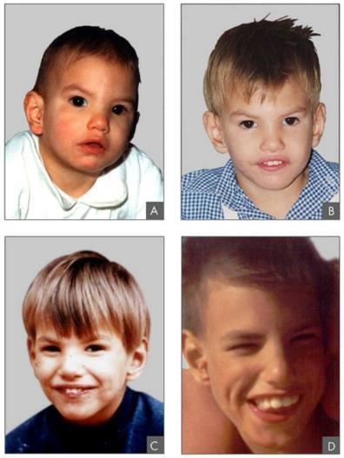
Figure 7.11
This individual with cri-du-chat syndrome is shown at various ages: (A) age two, (B) age four, (C) age nine, and (D) age 12. (credit: Paola Cerruti Mainardi)
This OpenStax ancillary resource is © Rice University under a CC-BY 4.0 International license; it may be reproduced or modified but must be attributed to OpenStax, Rice University and any changes must be noted. Any images credited to other sources are similarly available for reproduction, but must be attributed to their sources.

Slide 52
Chromosome Structural Rearrangements
(3 of 5)
Chromosome inversions and translocations can be identified by observing cells during meiosis
A chromosome inversion is the detachment, 180° rotation, and reinsertion of part of a chromosome (Figure 7.12)
Unless they disrupt a gene sequence, inversions only change the orientation of genes and are likely to have more mild effects than aneuploid errors

Slide 53
Chromosome Structural Rearrangements
(4 of 5)
A translocation occurs when a segment of a chromosome dissociates and reattaches to a different, nonhomologous chromosome
Translocations can be benign or have devastating effects, depending on how the positions of genes are altered with respect to regulatory sequences
Notably, specific translocations have been associated with several cancers and with schizophrenia

Slide 54
Chromosome Structural Rearrangements
(5 of 5)
Reciprocal translocations result from the exchange of chromosome segments between two nonhomologous chromosomes such that there is no gain or loss of genetic information (Figure 7.12)

Slide 55
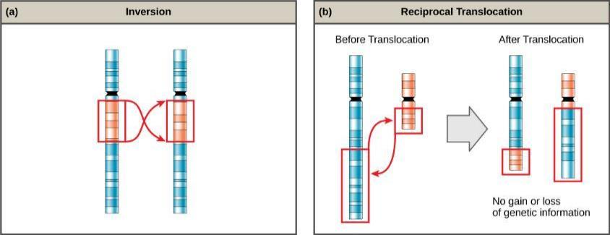
Figure 7.12
An (a) inversion occurs when a chromosome segment breaks from the chromosome, reverses its orientation, and then reattaches in the original position. A (b) reciprocal translocation occurs between two nonhomologous chromosomes and does not cause any genetic information to be lost or duplicated. (credit: modification of work by National Human Genome Research Institute (USA))
This OpenStax ancillary resource is © Rice University under a CC-BY 4.0 International license; it may be reproduced or modified but must be attributed to OpenStax, Rice University and any changes must be noted. Any images credited to other sources are similarly available for reproduction, but must be attributed to their sources.

