Slide 1
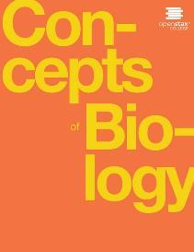

Concepts of Biology
Chapter 8 PATTERNS OF INHERITANCE
PowerPoint Image Slideshow

Slide 2
Introduction
Genetics - the study of heredity
Gregor Mendel set the framework for genetics long before chromosomes or genes had been identified
Mendel conducted methodical, quantitative analyses using large sample sizes and revealed the fundamental principles of heredity
We now know that genes, carried on chromosomes, are the basic functional units of heredity with the ability to be replicated, expressed, or mutated

Slide 3

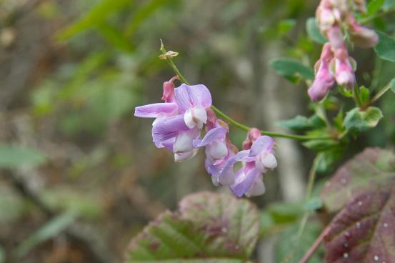
Figure 8.1
Experimenting with thousands of garden peas, Mendel uncovered the fundamentals of genetics. (credit: modification of work by Jerry Kirkhart)
This OpenStax ancillary resource is © Rice University under a CC-BY 4.0 International license; it may be reproduced or modified but must be attributed to OpenStax, Rice University and any changes must be noted. Any images credited to other sources are similarly available for reproduction, but must be attributed to their sources.

Slide 4
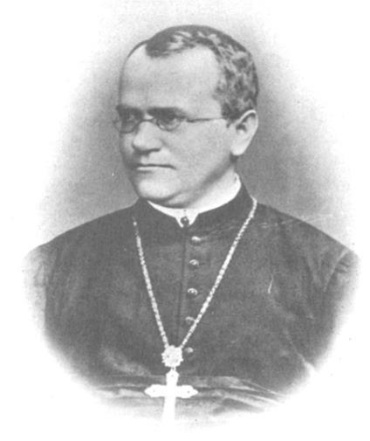
Figure 8.2
Johann Gregor Mendel set the framework for the study of genetics.
This OpenStax ancillary resource is © Rice University under a CC-BY 4.0 International license; it may be reproduced or modified but must be attributed to OpenStax, Rice University and any changes must be noted. Any images credited to other sources are similarly available for reproduction, but must be attributed to their sources.

Slide 5
8.1 MENDEL’S EXPERIMENTS (1 of 4)
Gregor Mendel, (1822–1884) supported by the monastery, taught physics, botany, and natural science courses at the secondary and university levels
In 1856, he began a decade-long research pursuit involving inheritance patterns in pea plants
In 1865, Mendel presented the results of his experiments with nearly 30,000 pea plants to the local natural history society
He demonstrated that traits are transmitted faithfully from parents to offspring in specific patterns

Slide 6
8.1 Mendel’s Experiments (2 of 4)
Mendel’s work went virtually unnoticed by the scientific community, which incorrectly believed that the process of inheritance involved a blending of parental traits that produced an intermediate physical appearance in offspring
This hypothetical process appeared to be correct because of what we know now as continuous variation

Slide 7
8.1 Mendel’s Experiments (3 of 4)
Mendel worked instead with traits that show discontinuous variation
Discontinuous variation - the variation seen among individuals when each individual shows one of two—or a very few—easily distinguishable traits, such as purple or white flowers
Mendel’s choice of these kinds of traits allowed him to see experimentally that the traits were not blended in the offspring, but that they were inherited as distinct traits

Slide 8
8.1 Mendel’s Experiments (4 of 4)
It was not until 1900 that his work was rediscovered, reproduced, and revitalized by scientists on the brink of discovering the chromosomal basis of heredity

Slide 9
Mendel’s Crosses (1 of 4)
Mendel’s work was accomplished using the garden pea, Pisum sativum, to study inheritance, this species:
    naturally self-fertilizes
    grows to maturity within one season
    large quantities could be cultivated simultaneously, allowing Mendel to conclude that his results did not come about simply by chance

Slide 10
Mendel’s Crosses (2 of 4)
Mendel performed hybridizations, which involve mating two true-breeding individuals that have different traits
In the pea, which is naturally self-pollinating, this is done by manually transferring pollen from the anther of a mature pea plant of one variety to the stigma of a separate mature pea plant of the second variety
Plants used in first-generation crosses were called P, or parental generation, plants (Figure 8.3)

Slide 11
Mendel’s Crosses (3 of 4)
Mendel collected the seeds produced by the P plants that resulted from each cross and grew them the following season
These offspring were called the F₁, or the first filial generation (filial = daughter or son)
Once Mendel examined the characteristics in the F₁ generation of plants, he allowed them to self-fertilize naturally
He then collected and grew the seeds from the F₁ plants to produce the F₂, or second filial generation

Slide 12
Mendel’s Crosses (4 of 4)
Mendel’s experiments extended beyond the F₂ generation to the F₃ generation, F₄ generation, and so on, but it was the ratio of characteristics in the P, F₁, and F₂ generations that were the most intriguing and became the basis of Mendel’s postulates

Slide 13
Figure 8.3
Mendel’s process for performing crosses included examining flower color.
This OpenStax ancillary resource is © Rice University under a CC-BY 4.0 International license; it may be reproduced or modified but must be attributed to OpenStax, Rice University and any changes must be noted. Any images credited to other sources are similarly available for reproduction, but must be attributed to their sources. Note: picture was modified to change the word violet to purple because the Punnett square uses P to denote that purple color is dominant to white.

Slide 14
Garden Pea Characteristics Revealed the Basics of Heredity (1 of 11)
Mendel reported the results of his crosses involving seven different characteristics, each with two contrasting traits
Trait - a variation in the physical appearance of a heritable characteristic
The characteristics included plant height, seed texture, seed color, flower color, pea-pod size, pea-pod color, and flower position
For the characteristic of flower color, for example, the two contrasting traits were white versus purple

Slide 15
Garden Pea Characteristics Revealed the Basics of Heredity (3 of 11)
First, Mendel confirmed that he was using plants that bred true for white or purple flower color, meaning all self-crossed offspring of parents with white flowers had white flowers, and all self-crossed offspring of parents with purple flowers had purple flowers

Slide 16
Garden Pea Characteristics Revealed the Basics of Heredity (4 of 11)
In addition, Mendel confirmed that, other than flower color, the pea plants were physically identical
This was an important check to make sure that the two varieties of pea plants only differed with respect to one trait, flower color
Mendel then applied the pollen from a plant with purple flowers to the stigma of a plant with white flowers (cross-pollination)
Mendel found that 100 percent of the F₁ hybrid generation had purple flowers

Slide 17
Garden Pea Characteristics Revealed the Basics of Heredity (5 of 11)
At that time, it would have been predicted the hybrid flowers to be pale purple or for hybrid plants to have equal numbers of white and purple flowers
In other words, the contrasting parental traits were expected to blend in the offspring
Instead, Mendel’s results demonstrated that the white flower trait had completely disappeared in the F₁ generation

Slide 18
Garden Pea Characteristics Revealed the Basics of Heredity (6 of 11)
Importantly, Mendel did not stop his experimentation there
He allowed the F₁ plants to self-fertilize and found that 705 plants in the F₂ generation had purple flowers and 224 had white flowers
This was a ratio of 3:1 purple flowers to one white flower

Slide 19
Garden Pea Characteristics Revealed the Basics of Heredity (8 of 11)
For the other six characteristics that Mendel examined, the F₁ and F₂ generations behaved in the same way that they behaved for flower color
One of the two traits would disappear completely from the F₁ generation, only to reappear in the F₂ generation at a ratio of roughly 3:1 (Figure 8.4)

Slide 20
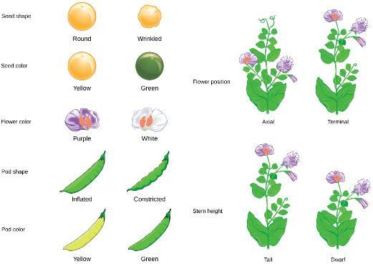
Figure 8.4
Mendel identified seven pea plant characteristics.
This OpenStax ancillary resource is © Rice University under a CC-BY 4.0 International license; it may be reproduced or modified but must be attributed to OpenStax, Rice University and any changes must be noted. Any images credited to other sources are similarly available for reproduction, but must be attributed to their sources.

Slide 21
Garden Pea Characteristics Revealed the Basics of Heredity (9 of 11)
Upon compiling his results for many thousands of plants, Mendel concluded that the characteristics could be divided into expressed and latent traits
He called these dominant and recessive traits, respectively
Dominant traits are those that are inherited unchanged in a hybridization
Recessive traits become latent, or disappear in the offspring of a hybridization
The recessive trait does, however, reappear in the progeny of the hybrid offspring

Slide 22
Garden Pea Characteristics Revealed the Basics of Heredity (10 of 11)
An example of a dominant trait is the purple colored flower trait
For this same characteristic (flower color), white-colored flowers are a recessive trait
The fact that the recessive trait reappeared in the F₂ generation meant that the traits remained separate (and were not blended) in the plants of the F₁ generation
Mendel proposed that the plants possessed two copies of the trait for the flower color characteristic, and each parent transmitted one of their two copies to their offspring, where they came together

Slide 23
Garden Pea Characteristics Revealed the Basics of Heredity (11 of 11)
Moreover, the physical observation of a dominant trait could mean that the genetic composition of the organism included two dominant versions of the characteristic, or that it included one dominant and one recessive version
Conversely, the observation of a recessive trait meant that the organism lacked any dominant versions of this characteristic

Slide 24
8.2 LAWS OF INHERITANCE (1 of 4)
The seven characteristics that Mendel evaluated in his pea plants were each expressed as one of two traits
Mendel deduced from his results that each individual had two discrete copies of the characteristic that are passed individually to offspring
We now call those two copies genes, which are carried on chromosomes

Slide 25
8.2 LAWS OF INHERITANCE (2 of 4)
The reason we have two copies of each gene is that we inherit one from each parent
In fact, it is the chromosomes we inherit and the two copies of each gene are located on paired chromosomes
Recall that in meiosis these chromosomes are separated out into haploid gametes
This separation, or segregation, of the homologous chromosomes also means that only one of the copies of the gene gets moved into a gamete

Slide 26
8.2 LAWS OF INHERITANCE (3 of 4)
The offspring are formed when one gamete unites with one from the other parent and the two copies of each gene (and chromosome) are restored
For cases in which a single gene controls a single characteristic, a diploid organism has two genetic copies that may or may not encode the same version of that characteristic
For example, one individual may carry a gene that determines white flower color and a gene that determines purple flower color

Slide 27
8.2 LAWS OF INHERITANCE (4 of 4)
Gene variants that arise by mutation and exist at the same relative locations on homologous chromosomes are called alleles
Mendel examined the inheritance of genes with just two allele forms, but it is common to encounter more than two alleles for any given gene in a natural population

Slide 28
Phenotypes and Genotypes (1 of 5)
Two alleles for a given gene in a diploid organism are expressed and interact to produce physical characteristics
The observable traits expressed by an organism are referred to as its phenotype
An organism’s underlying genetic makeup, consisting of both the physically visible and the non-expressed alleles, is called its genotype

Slide 29
Phenotypes and Genotypes (2 of 5)
Mendel’s hybridization experiments demonstrate the difference between phenotype and genotype
For example, seed color is governed by a single gene with two alleles
The yellow-seed allele is dominant and the green-seed allele is recessive

Slide 30
Phenotypes and Genotypes (3 of 5)
When true-breeding plants were cross-fertilized, in which one parent had yellow seeds and one had green seeds, all of the F₁ hybrid offspring had yellow seeds
That is, the hybrid offspring were phenotypically identical to the true-breeding parent with yellow seeds even though we know that the allele donated by the parent with green seeds was not simply lost because it reappeared in some of the F₂ offspring; therefore, the F₁ plants must have been genotypically different from the parent with yellow seeds

Slide 31
Phenotypes and Genotypes (4 of 5)
Genotype refers to the gene combination the organism inherited for a particular trait.
The dominant allele is capitalized and the recessive allele is lower case
The letter used for the gene (seed color in this case) is usually related to the dominant trait (yellow allele, in this case, or “Y”)
Homozygous organisms have two identical alleles (genotype is often written as YY or yy)
Heterozygous organisms have two different alleles (genotype is often written as Yy)

Slide 32
Phenotypes and Genotypes (5 of 5)
Mendel’s parental pea plants always bred true because both produced gametes carried the same allele
When P generation plants with contrasting traits were cross-fertilized, all of the offspring were heterozygous for the contrasting trait, meaning their genotype had different alleles for the gene being examined
For example, the F₁ yellow plants that received a Y allele from their yellow parent and a y allele from their green parent had the genotype Yy

Slide 33
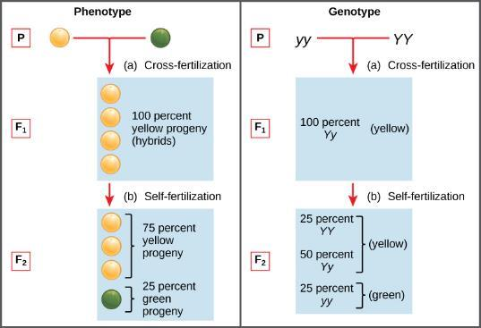
Figure 8.5
Phenotypes are physical expressions of traits that are transmitted by alleles. Capital letters represent dominant alleles and lowercase letters represent recessive alleles. The phenotypic ratios are the ratios of visible characteristics. The genotypic ratios are the ratios of gene combinations in the offspring, and these are not always distinguishable in the phenotypes.
This OpenStax ancillary resource is © Rice University under a CC-BY 4.0 International license; it may be reproduced or modified but must be attributed to OpenStax, Rice University and any changes must be noted. Any images credited to other sources are similarly available for reproduction, but must be attributed to their sources.

Slide 34
Law of Dominance (1 of 3)
Our discussion of homozygous and heterozygous organisms brings us to why the F₁ heterozygous offspring were identical to one of the parents, rather than expressing both alleles
In all seven pea-plant characteristics, one of the two contrasting alleles was dominant, and the other was recessive
Mendel called the dominant allele the expressed unit factor; the recessive allele was referred to as the latent unit factor

Slide 35
Law of Dominance (2 of 3)
We now know that these so-called unit factors are actually genes on homologous chromosomes
For a gene that is expressed in a dominant and recessive pattern, homozygous dominant and heterozygous organisms will look identical (that is, they will have the same phenotype but different genotypes)
The recessive allele will only be observed in homozygous recessive individuals (Table 8.1)

Slide 36
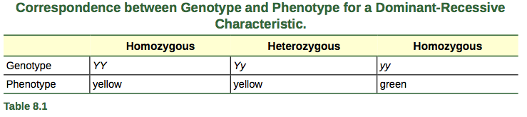
Correspondence of Genotype and Phenotype

Slide 37
Law of Dominance (3 of 3)
Mendel’s law of dominance states that in a heterozygote, one trait will conceal the presence of another trait for the same characteristic
For example, when crossing true-breeding purple-flowered plants with true-breeding white-flowered plants, all of the offspring were purple-flowered, even though they all had one allele for purple and one allele for white

Slide 38
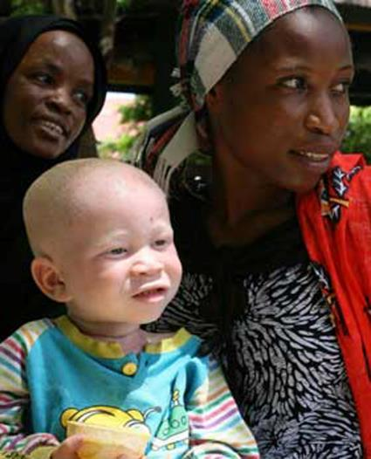
Figure 8.6
The allele for albinism, expressed here in humans, is recessive. Both of this child’s parents carried the recessive allele.
This OpenStax ancillary resource is © Rice University under a CC-BY 4.0 International license; it may be reproduced or modified but must be attributed to OpenStax, Rice University and any changes must be noted. Any images credited to other sources are similarly available for reproduction, but must be attributed to their sources.

Slide 39
Monohybrid Cross and the Punnett Square (1 of 6)
Hybrid means a combination of different alleles
When fertilization occurs between two true-breeding parents that differ by only the characteristic being studied, the process is called a monohybrid cross, and the resulting offspring are called monohybrids
Mendel performed seven types of monohybrid crosses, each involving contrasting traits for different characteristics

Slide 40
Monohybrid Cross and the Punnett Square (2 of 6)
Out of these crosses, all of the F₁ offspring had the phenotype of one parent, and the F₂ offspring had a 3:1 phenotypic ratio
The results of Mendel’s research can be explained mathematically in terms of probabilities

Slide 41
Monohybrid Cross and the Punnett Square (3 of 6)
To demonstrate this with a monohybrid cross, consider the case of true-breeding pea plants with yellow versus green seeds
The dominant seed color is yellow; therefore, the parental genotypes were YY for the plants with yellow seeds and yy for the plants with green seeds
A Punnett square (devised by the British geneticist Reginald Punnett) is useful for determining probabilities because it is drawn to predict all possible outcomes of all possible random fertilization events and their expected frequencies

Slide 42
Monohybrid Cross and the Punnett Square (4 of 6)
Figure 8.9 shows a Punnett square for a cross between a plant with yellow peas and one with green peas
To prepare a Punnett square, all possible combinations of the parental alleles (the genotypes of the gametes) are listed along the top (for one parent) and side (for the other parent) of a grid
The combinations of egg and sperm gametes are then made in the boxes in the table on the basis of which alleles are combining
Each box then represents the diploid genotype of a zygote, or fertilized egg

Slide 43
Monohybrid Cross and the Punnett Square (5 of 6)
Because each possibility is equally likely, genotypic ratios can be determined from a Punnett square
If the pattern of inheritance (dominant and recessive) is known, the phenotypic ratios can be inferred as well
In this case, only one genotype is possible in the F₁ offspring: All offspring are Yy and have yellow seeds

Slide 44
Monohybrid Cross and the Punnett Square (6 of 6)
When the F₁ offspring are crossed with each other, genotypically the result is:
    25% (1 in 4) YY
    50% (2 in 4) Yy
    25% (1 in 4) yy
Phenotypically, this result is:
    75% (3 in 4) yellow
    25% (1 in 4) green
This explains why the results of Mendel’s F₂ generation occurred in a 3:1 phenotypic ratio

Slide 45
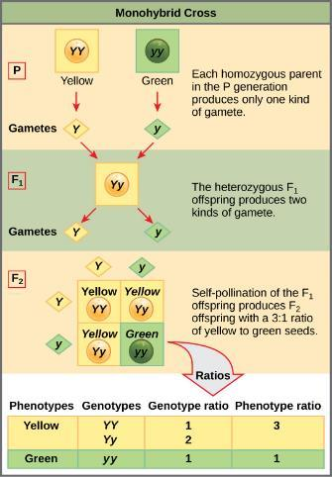
Figure 8.9
This Punnett square shows the cross between plants with yellow seeds and green seeds. The cross between the true-breeding P plants produces F₁ heterozygotes that can be self-fertilized. The self-cross of the F₁ generation can be analyzed with a Punnett square to predict the genotypes of the F₂ generation. Given an inheritance pattern of dominant–recessive, the genotypic and phenotypic ratios can then be determined.
This OpenStax ancillary resource is © Rice University under a CC-BY 4.0 International license; it may be reproduced or modified but must be attributed to OpenStax, Rice University and any changes must be noted. Any images credited to other sources are similarly available for reproduction, but must be attributed to their sources.

Slide 46
Law of Segregation (1 of 2)
Observing that true-breeding pea plants with contrasting traits gave rise to F₁ generations that all expressed the dominant trait and F₂ generations that expressed the dominant and recessive traits in a 3:1 ratio, Mendel proposed the law of segregation
This law states that paired unit factors (genes) must segregate equally into gametes such that offspring have an equal likelihood of inheriting either factor

Slide 47
Law of Segregation (2 of 2)
The physical basis of Mendel’s law of segregation is the first division of meiosis in which the homologous chromosomes with their different versions of each gene are segregated into daughter nuclei (but remember, this process was not understood by the scientific community during Mendel’s lifetime)

Slide 48
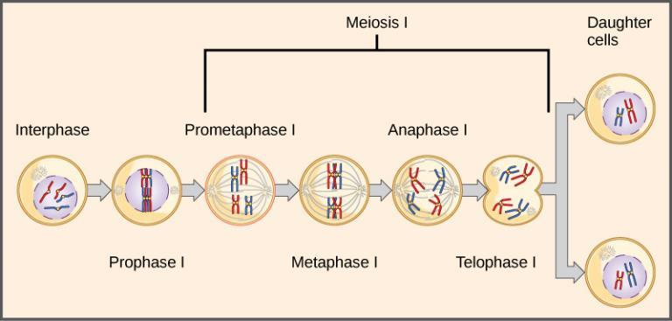
Figure 8.7
The first division in meiosis is shown.
This OpenStax ancillary resource is © Rice University under a CC-BY 4.0 International license; it may be reproduced or modified but must be attributed to OpenStax, Rice University and any changes must be noted. Any images credited to other sources are similarly available for reproduction, but must be attributed to their sources.

Slide 49
Test Cross (1 of 2)
Beyond predicting the offspring of a cross between known homozygous or heterozygous parents, Mendel also developed a way to determine whether an organism that expressed a dominant trait was a heterozygote or a homozygote
This technique, called the test cross, is still used by plant and animal breeders

Slide 50
Test Cross (2 of 2)
In a test cross, the dominant-expressing organism is crossed with an organism that is homozygous recessive for the same characteristic
If the dominant-expressing organism is a homozygote, then all F₁ offspring will be heterozygotes expressing the dominant trait
Alternatively, if the dominant-expressing organism is a heterozygote, the F₁ offspring will exhibit a 1:1 ratio of heterozygotes and recessive homozygotes

Slide 51
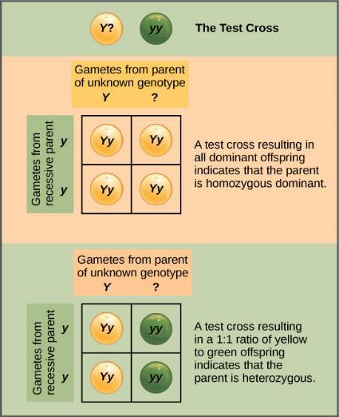
Figure 8.8
A test cross can be performed to determine whether an organism expressing a dominant trait is a homozygote or a heterozygote.
This OpenStax ancillary resource is © Rice University under a CC-BY 4.0 International license; it may be reproduced or modified but must be attributed to OpenStax, Rice University and any changes must be noted. Any images credited to other sources are similarly available for reproduction, but must be attributed to their sources.

Slide 52
Law of Independent Assortment (1 of 6)
Mendel’s law of independent assortment states that genes do not influence each other with regard to the sorting of alleles into gametes, and every possible combination of alleles for every gene is equally likely to occur
Independent assortment of genes can be illustrated by the dihybrid cross, a cross between two true-breeding parents that express different traits for two characteristics

Slide 53
Law of Independent Assortment (2 of 6)
Consider the characteristics of seed color and seed texture for two pea plants, one that has wrinkled, green seeds (rryy) and another that has round, yellow seeds (RRYY)
Because each parent is homozygous, the law of segregation indicates that the gametes for the wrinkled–green plant all are ry, and the gametes for the round–yellow plant are all RY. Therefore, the F₁ generation of offspring all are RrYy (Figure 8.10)

Slide 54
Law of Independent Assortment (3 of 6)
The gametes produced by the F₁ individuals must have one allele from each of the two genes
For example, a gamete could get the R allele or the r allele for the seed shape gene and either the Y or the y allele for the seed color gene

Slide 55
Law of Independent Assortment (4 of 6)
The law of independent assortment states that a gamete into which an r allele is sorted would be equally likely to contain either a Y or a y allele
Thus, there are four equally likely gametes that can be formed when the RrYy heterozygote is self-crossed, as follows: RY, rY, Ry, and ry

Slide 56
Law of Independent Assortment (5 of 6)
Arranging these gametes along the top and left of a 4 × 4 Punnett square (Figure 8.10) gives us 16 equally likely genotypic combinations
From these genotypes, we find a phenotypic ratio of 9 round–yellow:3 round–green:3 wrinkled–yellow:1 wrinkled–green (Figure 8.10)
These are the offspring ratios we would expect, assuming we performed the crosses with a large enough sample size

Slide 57
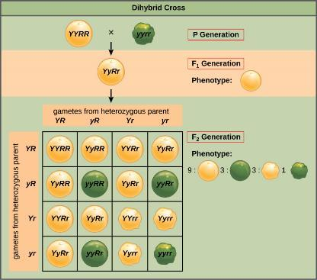
Figure 8.10
A dihybrid cross in pea plants involves the genes for seed color and texture. The P cross produces F₁ offspring that are all heterozygous for both characteristics. The resulting 9:3:3:1 F₂ phenotypic ratio is obtained using a Punnett square.
This OpenStax ancillary resource is © Rice University under a CC-BY 4.0 International license; it may be reproduced or modified but must be attributed to OpenStax, Rice University and any changes must be noted. Any images credited to other sources are similarly available for reproduction, but must be attributed to their sources.

Slide 58
Law of Independent Assortment (6 of 6)
The physical basis for the law of independent assortment also lies in meiosis I, in which the different homologous pairs line up in random orientations
Each gamete can contain any combination of paternal and maternal chromosomes (and therefore the genes on them) because the orientation of tetrads on the metaphase plane is random (Figure 8.11)

Slide 59
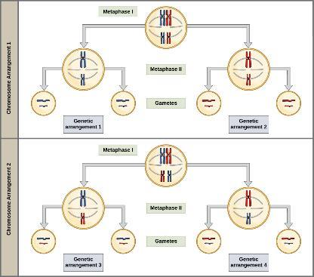
Figure 8.11
The random segregation into daughter nuclei that happens during the first division in meiosis can lead to a variety of possible genetic arrangements.
This OpenStax ancillary resource is © Rice University under a CC-BY 4.0 International license; it may be reproduced or modified but must be attributed to OpenStax, Rice University and any changes must be noted. Any images credited to other sources are similarly available for reproduction, but must be attributed to their sources.

Slide 60
8.3 EXTENSIONS OF THE LAWS OF INHERITANCE
Mendel studied traits with only one mode of inheritance in pea plants, the relatively simple pattern of dominant and recessive alleles for a single characteristic
There are several important modes of inheritance (discovered after Mendel’s work) that do not follow the dominant and recessive, single-gene model

Slide 61
Alternatives to Dominance and Recessiveness (1 of 2)
Mendel’s experiments with pea plants suggested that:
1) two types of “units” or alleles exist for every gene
2) alleles maintain their integrity in each generation
(no blending)
3) in the presence of the dominant allele, the recessive allele is hidden, with no contribution to the phenotype
Therefore, recessive alleles can be “carried” and not expressed by individuals
Such heterozygous individuals are sometimes referred to as “carriers”

Slide 62
Alternatives to Dominance and Recessiveness (2 of 2)
Since then, genetic studies in other organisms have shown that much more complexity exists, but that the fundamental principles of Mendelian genetics still hold true
Other types of inheritance patterns are considered extensions of Mendelism

Slide 63
Incomplete Dominance (1 of 3)
Mendel’s results, demonstrating that traits are inherited as dominant and recessive pairs, contradicted the view at that time that offspring exhibited a blend of their parents’ traits
However, the heterozygote phenotype occasionally does appear to be intermediate between the two parents

Slide 64
Incomplete Dominance (2 of 2)
For example, in the snapdragon, Antirrhinum majus (Figure 8.12), a cross between a homozygous parent with white flowers (C^{W}C^{W}) and a homozygous parent with red flowers (C^{R}C^{R}) will produce
offspring with pink flowers (C^{R}C^{W}) (Note
that different genotypic abbreviations are
used for Mendelian extensions to
distinguish these patterns from simple
dominance and recessiveness)
This pattern of inheritance is described as incomplete dominance

Slide 65
Incomplete Dominance (3 of 3)
The allele for red flowers is incompletely dominant over the allele for white flowers
However, the results of a heterozygote self-cross can still be predicted, just as with Mendelian dominant and recessive crosses
In this case, the genotypic ratio would be 1 C^{R}C^{R} : 2 C^{R}C^{W} : 1 C^{W}C^{W}, and the phenotypic ratio would be 1:2:1 for red:pink:white

Slide 66
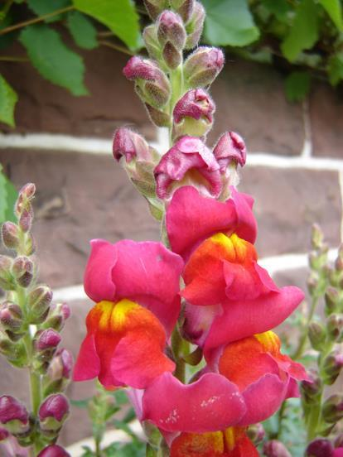
Figure 8.12
These pink flowers of a heterozygote snapdragon result from incomplete dominance. (credit: “storebukkebruse”/Flickr)
This OpenStax ancillary resource is © Rice University under a CC-BY 4.0 International license; it may be reproduced or modified but must be attributed to OpenStax, Rice University and any changes must be noted. Any images credited to other sources are similarly available for reproduction, but must be attributed to their sources.

Slide 67
Codominance (1 of 3)
A variation on incomplete dominance is codominance, in which both alleles for the same characteristic are simultaneously expressed in the heterozygote
An example of codominance occurs in the ABO blood groups of humans

Slide 68
Codominance (2 of 3)
The A and B alleles are expressed in the form of A or B molecules present on the surface of red blood cells
Homozygotes (I^{A}I^{A} and I^{B}I^{B}) express either the A or the B phenotype, and heterozygotes (I^{A}I^{B}) express both phenotypes equally
The I^{A}I^{B} individual has blood type AB

Slide 69
Codominance (3 of 3)
Crossing two parents with blood type AB, there are three possible offspring genotypes and phenotypes (Figure 8.13)

Slide 70
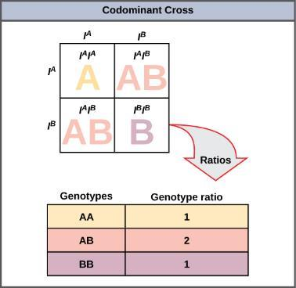
Figure 8.13
This Punnett square shows an AB/AB blood type cross
This OpenStax ancillary resource is © Rice University under a CC-BY 4.0 International license; it may be reproduced or modified but must be attributed to OpenStax, Rice University and any changes must be noted. Any images credited to other sources are similarly available for reproduction, but must be attributed to their sources.

Slide 71
Multiple Alleles (1 of 4)
Mendel implied that only two alleles, one dominant and one recessive, could exist for a given gene, we now know that this is an oversimplification
Although individual humans (and all diploid organisms) can only have two alleles for a given gene, multiple alleles may exist at the population level, such that many combinations of two alleles are observed

Slide 72
Multiple Alleles (2 of 4)
Note that when many alleles exist for the same gene, the convention is to denote the most common phenotype or genotype in the natural population as the wild type (often abbreviated “+”)
All other phenotypes or genotypes are considered variants (mutants) of this typical form, meaning they deviate from the wild type
The variant may be recessive or dominant to the wild-type allele

Slide 73
Multiple Alleles (3 of 4)
An example of multiple alleles is the ABO blood-type system in humans
In this case, there are three alleles circulating in the population: the I^{A} allele codes for A molecules on the red blood cells, the I^{B} allele codes for B molecules on the surface of red blood cells, and the i allele codes for no molecules on the red blood cells
In this case, the I^{A} and I^{B} alleles are codominant with each other and are both dominant over the recessive i allele

Slide 74
Multiple Alleles (4 of 4)
Although there are three alleles present in a population, each individual only gets two of the alleles, one from each of their parents
This produces the genotypes and phenotypes shown in Figure 8.14
Notice that instead of three genotypes, there are six different genotypes when there are three alleles
The number of possible phenotypes depends on the dominance relationships between the three alleles

Slide 75
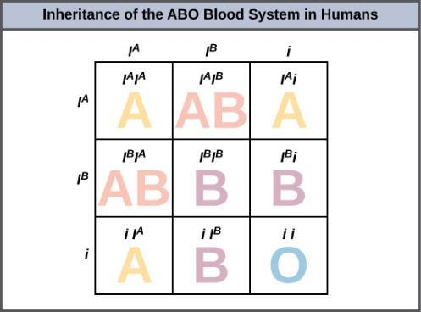
Figure 8.14
Inheritance of the ABO blood system in humans is shown.
This OpenStax ancillary resource is © Rice University under a CC-BY 4.0 International license; it may be reproduced or modified but must be attributed to OpenStax, Rice University and any changes must be noted. Any images credited to other sources are similarly available for reproduction, but must be attributed to their sources.

Slide 76
Sex-Linked Traits (1 of 7)
In humans, as well as in many other animals and some plants, the sex of the individual is determined by sex chromosomes—one pair of non-homologous chromosomes
In addition to 22 homologous pairs of autosomes, human females have a homologous pair of X chromosomes, whereas human males have an XY chromosome pair

Slide 77
Sex-Linked Traits (2 of 7)
Although the Y chromosome contains a small region of similarity to the X chromosome so that they can pair during meiosis, the Y chromosome is much shorter and contains fewer genes
When a gene being examined is present on the X, but not the Y chromosome, it is called X-linked

Slide 78
Sex-Linked Traits (3 of 7)
Eye color in Drosophila, the common fruit fly, was the first X-linked trait to be identified
Thomas Hunt Morgan mapped this trait to the X chromosome in 1910
Like humans, Drosophila males have an XY chromosome pair, and females are XX
In flies the wild-type eye color is red (X^{W}) and is dominant to white eye color (X^{w}) (Figure 8.15)

Slide 79
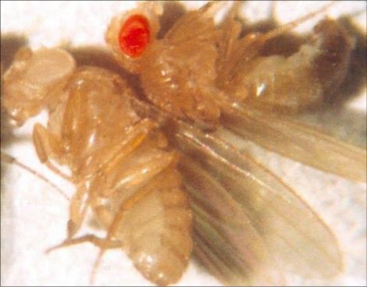
Figure 8.15
In Drosophila, the gene for eye color is located on the X chromosome. Red eye color is wild-type and is dominant to white eye color.
This OpenStax ancillary resource is © Rice University under a CC-BY 4.0 International license; it may be reproduced or modified but must be attributed to OpenStax, Rice University and any changes must be noted. Any images credited to other sources are similarly available for reproduction, but must be attributed to their sources.

Slide 80
Sex-Linked Traits (4 of 7)
With respect to Drosophila eye color, when the P male expresses the white-eye phenotype and the female is homozygously red-eyed, all members of the F₁ generation exhibit red eyes (Figure 8.16)

Slide 81
Figure 8.16-a
as is the case for this cross involving red and white eye color in Drosophila. In the diagram, w is the white-eye mutant allele and W is the wild-type, red-eye allele. The female is homozygous for the wild-type, red eyes; the male is hemizygous for the recessive white eyes. All offspring will inherit the dominant red eye allele from the female and will therefore exhibit red eyes. (original illustration modified to show the example cross described)
This OpenStax ancillary resource is © Rice University under a CC-BY 4.0 International license; it may be reproduced or modified but must be attributed to OpenStax, Rice University and any changes must be noted. Any images credited to other sources are similarly available for reproduction, but must be attributed to their sources.

Slide 82
Sex-Linked Traits (5 of 7)
Now, consider a cross between a homozygous white-eyed female and a male with red eyes
The F₁ generation would exhibit only heterozygous red-eyed females (X^{W}X^{w}) and only white-eyed males (X^{w}Y)

Slide 83
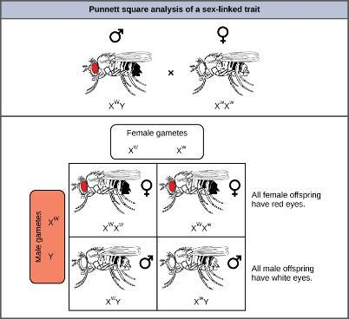
Figure 8.16-b
Crosses involving sex-linked traits often give rise to different phenotypes for the different sexes of offspring, as is the case for this cross involving red and white eye color in Drosophila. In the diagram, w is the white-eye mutant allele and W is the wild-type, red-eye allele.
This OpenStax ancillary resource is © Rice University under a CC-BY 4.0 International license; it may be reproduced or modified but must be attributed to OpenStax, Rice University and any changes must be noted. Any images credited to other sources are similarly available for reproduction, but must be attributed to their sources.

Slide 84
Sex-Linked Traits (6 of 7)
In humans, the alleles for certain conditions (some color-blindness, hemophilia, and muscular dystrophy) are X-linked
Females who are heterozygous for these diseases are said to be carriers and may not exhibit any phenotypic effects
These females will pass the disease to half of their sons and will pass carrier status to half of their daughters; therefore, X-linked traits appear more frequently in males than females

Slide 85
Sex-Linked Traits (7 of 7)
In some groups of organisms with sex chromosomes, the sex with the non-homologous sex chromosomes is the female rather than the male (for example, birds)
In this case, sex-linked traits will be more likely to appear in the female, because they are hemizygous

Slide 86
Linked Genes Violate the Law of Independent Assortment (1 of 2)
Genes that are located on separate, nonhomologous chromosomes will always sort independently
However, each chromosome contains hundreds or thousands of genes, organized linearly on chromosomes like beads on a string
The segregation of alleles into gametes can be influenced by linkage, in which genes that are located physically close to each other on the same chromosome are more likely to be inherited as a pair

Slide 87
Linked Genes Violate the Law of Independent Assortment (2 of 2)
However, because of the process of recombination, or “crossover,” it is possible for two genes on the same chromosome to behave independently, or as if they are not linked
Recall that during interphase and prophase I of meiosis, homologous chromosomes first replicate and then synapse, and exchange linear segments of genetic material (Figure 8.17)
This process is called recombination, or crossover, and it is a common genetic process

Slide 88
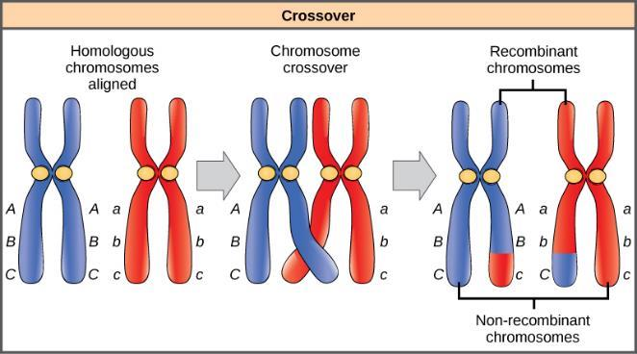
Figure 8.17
The process of crossover, or recombination, occurs when two homologous chromosomes align and exchange a segment of genetic material.
This OpenStax ancillary resource is © Rice University under a CC-BY 4.0 International license; it may be reproduced or modified but must be attributed to OpenStax, Rice University and any changes must be noted. Any images credited to other sources are similarly available for reproduction, but must be attributed to their sources.

Slide 89
Epistasis (1 of 2)
Genes may also oppose each other, with one gene suppressing the expression of another
In epistasis, the interaction between genes is antagonistic, such that one gene masks or interferes with the expression of another
Epistasis - a gene pathway in which expression of one gene is dependent on the function of a gene that precedes or follows it in the pathway

Slide 90
Epistasis (2 of 2)
An example of epistasis is pigmentation in Labrador dogs
Labradors inherit genes for producing fur pigment: black(B) is dominant to brown(b)
They also inherit genes for depositing this pigment into the fur (these are the epistasis genes): E is dominant and deposits the pigment into the fur, e is recessive and does not deposit the pigment into the fur
If a dog is homozygous recessive for the epistasis gene, the pigment is not deposited into the fur, therefore they are a yellow lab

Slide 91
Epistasis
Image of epistasis genotypes in Labrador dogs created by Tracie Bates

