Slide 1
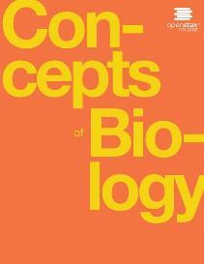
Concepts of Biology
Chapter 12 DIVERSITY OF LIFE
PowerPoint Image Slideshow

Slide 2
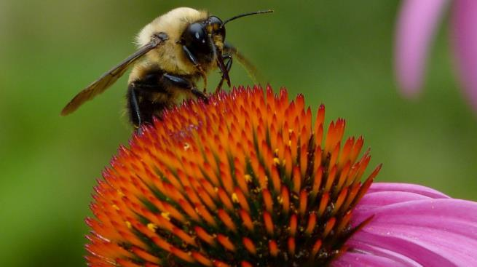
Figure 12.1 all living organisms on earth are related
Although they look different, this bee and flower are distantly related. (credit: modification of work by John Beetham)
This OpenStax ancillary resource is © Rice University under a CC-BY 4.0 International license; it may be reproduced or modified but must be attributed to OpenStax, Rice University and any changes must be noted. Any images credited to other sources are similarly available for reproduction, but must be attributed to their sources.

Slide 3
Organizing life on earth 1 OF 2 (12.1)
All life on earth evolved from a common ancestor.
Biologists map how organisms are related by constructing phylogenetic trees, which show when organisms evolved and shows relationships among different organisms (Figure 12.2).
The 3 domains of life (Archaea, Bacteria and Eukarya) arise from a single point, diverge and then branch repeatedly.
In a phylogenetic tree, the pathway can be traced from the origin of life to any individual species.
Also, by starting at a single species and tracing back to any branch point, the organisms related to it can be identified.

Slide 4
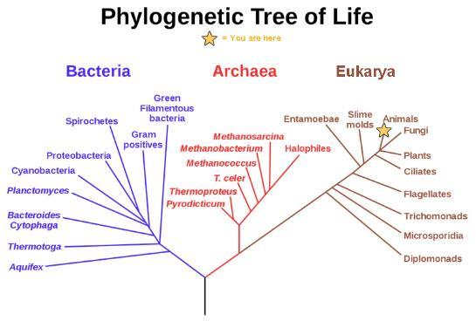
Figure 12.2 tree of life
In the evolution of life on Earth, the three domains of life—Archaea, Bacteria, and Eukarya—branch from a single point. (credit: modification of work by Eric Gaba)
This OpenStax ancillary resource is © Rice University under a CC-BY 4.0 International license; it may be reproduced or modified but must be attributed to OpenStax, Rice University and any changes must be noted. Any images credited to other sources are similarly available for reproduction, but must be attributed to their sources.

Slide 5
Organizing life on earth 2 OF 2 (12.1)
A phylogeny is the evolutionary history and the relationships among a species or group of species.
The study of organisms with the purpose of deriving their relationships is called systematics.
Many disciplines within biology contribute to systematics, including data from:
Fossils
Studying morphology
The structure of body parts
Molecular structure (DNA, RNA or amino acids in proteins)
Trees change as new data arrives, such as the discovery of new species or new character information.

Slide 6
The levels of classification 1 OF 3 (12.1)
Taxonomy is the science of naming and grouping species to construct an internationally shared classification system.
The classification system is named after Carolus Linnaeus (a Swedish naturalist), its inventor.
The taxonomic system is a hierarchical system in which each group includes all the groups at the next lowest level. The levels are:
Domain (the largest group): there are 3 domains (Archaea, Bacteria and Eukarya)
Kingdom: there are several kingdoms
Phylum
Class
Order
Family
Genus
Species (the smallest group, a single species)

Slide 7
The levels of classification 2 OF 3 (12.1)
The classification levels for the domestic dog are shown in Figure 12.3.
The group at each level is called a taxon (plural, taxa).
Scientists refer to each organism using a two part naming system called binomial nomenclature.
The two part name is the genus and species (latin or scientific name)
The genus name is capitalized and the species name is lowercase
The two part name is underlined or italicized
For example, the wolf is Canis lupus
The domestic dog is a subspecies of the wolf, Canis lupus familiaris

Slide 8
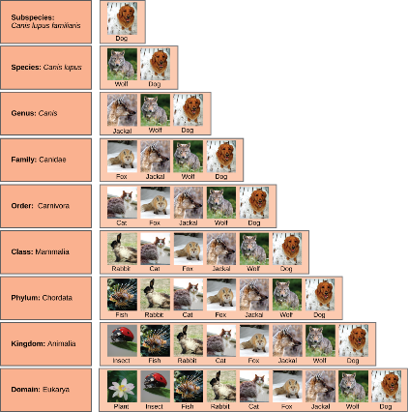
Figure 12.3 classification of the domestic dog
At each sublevel in the taxonomic classification system, organisms become more similar. Dogs and wolves are the same species because they can breed and produce viable offspring, but they are different enough to be classified as different subspecies. (credit “plant”: modification of work by "berduchwal"/Flickr; credit “insect”: modification of work by Jon Sullivan; credit “fish”: modification of work by Christian Mehlführer; credit “rabbit”: modification of work by Aidan Wojtas; credit “cat”: modification of work by Jonathan Lidbeck; credit “fox”: modification of work by Kevin Bacher, NPS; credit “jackal”: modification of work by Thomas A. Hermann, NBII, USGS; credit “wolf” modification of work by Robert Dewar; credit “dog”: modification of work by "digital_image_fan"/Flickr)
This OpenStax ancillary resource is © Rice University under a CC-BY 4.0 International license; it may be reproduced or modified but must be attributed to OpenStax, Rice University and any changes must be noted. Any images credited to other sources are similarly available for reproduction, but must be attributed to their sources.

Slide 9
The levels of classification 3 OF 3 (12.1)
Taxonomic levels move toward specificity.
At each sublevel, the organisms become more similar because they are more closely related.
Since Darwin’s theory was published in the 19th century, biologists work to make the classification system reflect evolutionary relationships.
All members of a taxon should have a common ancestor and be more closely related to each other than to members of other taxa.
Changes and updates are made as new discoveries take place.
For example, the prokaryotes were recently divided into 2 separate domains (Archaea and Bacteria) because they are so different genetically.

Slide 10
TAXONOMY Concept in action
Visit this PBS site to learn more about taxonomy. Under Classifying Life, click Launch Interactive.
http://openstaxcollege.org/l/classify_life2

Slide 11
classification and phylogeny 1 OF 2 (12.1)
A phylogenetic tree is a diagram used to reflect evolutionary relationships among organisms or groups of organisms.
Scientists consider phylogenetic trees to be a hypothesis of the evolutionary past because one cannot go back in time to confirm the proposed relationships
A phylogenetic tree is constructed using shared characteristics and can be read like a map of evolutionary history (Figure 12.4).
Branch point→ the point where a split occurs in a tree
Represents where a single lineage evolved into distinct new ones
Rooted→ a tree with a single ancestral lineage to which all organisms represented in the diagram relate
Sister taxa→ two lineages that diverged from the same branch point
For example, the 2 groups of orangutans are sister taxa

Slide 12
Figure 12.4 phylogenetic tree
A phylogenetic tree is rooted and shows how different organisms, in this case the species and subspecies of living apes, evolved from a common ancestor.
This OpenStax ancillary resource is © Rice University under a CC-BY 4.0 International license; it may be reproduced or modified but must be attributed to OpenStax, Rice University and any changes must be noted. Any images credited to other sources are similarly available for reproduction, but must be attributed to their sources.

Slide 13
classification and phylogeny 2 OF 2 (12.1)
The branch points in a phylogenetic tree also imply evolutionary change.
Sometimes the significant character changes are identified on a branch or branch point (Figure 12.5)
For example, the branch point that gives rise to the mammal and reptile lineages from the frog lineages shows the origin of the amniotic egg character

Slide 14
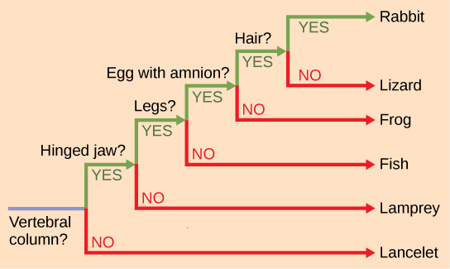
Figure 12.5 phylogenetic tree
This phylogenetic tree is rooted by an organism that lacked a vertebral column. At each branch point, organisms with different characters are placed in different groups.
This OpenStax ancillary resource is © Rice University under a CC-BY 4.0 International license; it may be reproduced or modified but must be attributed to OpenStax, Rice University and any changes must be noted. Any images credited to other sources are similarly available for reproduction, but must be attributed to their sources.

Slide 15
SPECIES Concept in action
This interactive exercise allows you to explore the evolutionary relationships among species.
http://openstaxcollege.org/l/tree_of_life3

Slide 16
Limitations of phylogenetic trees (12.1)
It is easy to assume that more closely related organisms look alike, but this is not always true (Figure 12.5).
Two closely related lineages could evolve under different surroundings or a major adaptation could evolve
Then closely related lineages could look quite different from each other
For example, rabbits and lizards are more closely related (by the presence of an amniotic egg) than lizards and salamanders (even though they look more alike)
Also, unless otherwise noted, the branch points do not indicated length of time (only the order in time of evolutionary events)
For example, the tree does not indicate how much time has passed between the evolution of amniotic eggs and hair, just the order in which things took place.

Slide 17
Determining evolutionary relationships (12.2)
In the case of phylogeny, evolutionary investigations focus on 2 types of evidence:
Morphologic (form and function)
Genetic

Slide 18
Two measures of similarity (12.2)
Organisms that share similar physical features AND genetic sequences tend to be more closely related than those that do not
Features that overlap both in morphology and genetics are called homologous structures
For example, the bones in the forelimbs of vertebrates (Figure 12.6) are homologous and indicate that these organisms share a common evolutionary past
Some organisms may be closely related even though they look quite different due to a minor genetic change causing a major morphological difference. This can be misleading.
For example, the chimpanzee skull and human skull look quite different even though these organisms are closely related (Figure 12.7)

Slide 19
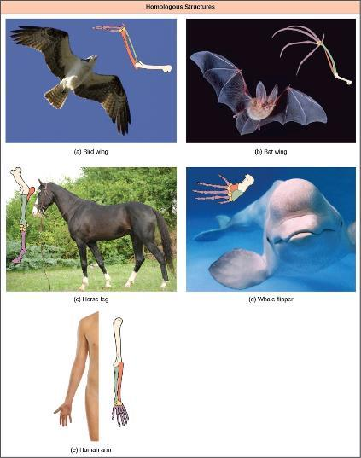
Figure 12.6 homologous structures
Bat and bird wings, the foreleg of a horse, the flipper of a whale, and the arm of a human are homologous structures, indicating that bats, birds, horses, whales, and humans share a common evolutionary past. (credit a photo: modification of work by Steve Hillebrand, USFWS; credit b photo: modification of work by U.S. BLM; credit c photo: modification of work by Virendra Kankariya; credit d photo: modification of work by Russian Gov./Wikimedia Commons)
This OpenStax ancillary resource is © Rice University under a CC-BY 4.0 International license; it may be reproduced or modified but must be attributed to OpenStax, Rice University and any changes must be noted. Any images credited to other sources are similarly available for reproduction, but must be attributed to their sources.

Slide 20
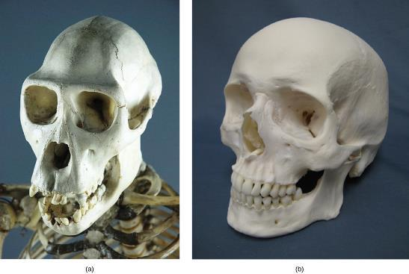
Figure 12.7 chimpanzee vs human jaw
(a) The chimpanzee jaw protrudes to a much greater degree than (b) the human jaw.
(credit a: modification of work by "Pastorius"/Wikimedia Commons)
This OpenStax ancillary resource is © Rice University under a CC-BY 4.0 International license; it may be reproduced or modified but must be attributed to OpenStax, Rice University and any changes must be noted. Any images credited to other sources are similarly available for reproduction, but must be attributed to their sources.

Slide 21
Determining evolutionary relationships 1 OF 3 (12.2)
In contrast, unrelated organisms may appear very much alike even though they are only distantly related. This is also misleading.
This usually occurs because common adaptations to similar environmental conditions evolved in both
When organisms evolve similar characteristics because they are adapting to similar environments (convergent evolution), the structures are called analogous structures
For example, the wings of insects, appear similar to the wings of bats and birds. However, insects are not closely related to bats and birds and the embryonic origin of the wings are different (Figure 12.8)
Similar traits can be either homologous or analogous.

Slide 22
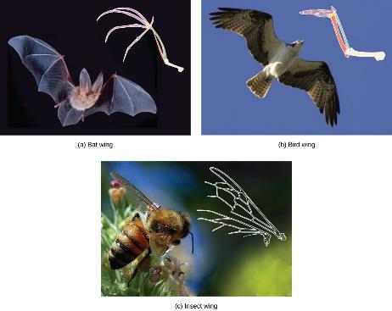
Figure 12.8 analogous structures
The wing of a honey bee is similar in shape to a bird wing and a bat wing and serves the same function (flight). The bird and bat wings are homologous structures. However, the honey bee wing has a different structure (it is made of a chitinous exoskeleton, not a boney endoskeleton) and embryonic origin. The bee and bird or bat wing types illustrate an analogy—similar structures that do not share an evolutionary history. (credit a photo: modification of work by U.S. BLM; credit b: modification of work by Steve Hillebrand, USFWS; credit c: modification of work by Jon Sullivan)
This OpenStax ancillary resource is © Rice University under a CC-BY 4.0 International license; it may be reproduced or modified but must be attributed to OpenStax, Rice University and any changes must be noted. Any images credited to other sources are similarly available for reproduction, but must be attributed to their sources.

Slide 23
PHYLOGENETIC Concept in action
This website has several examples to show how appearances can be misleading in understanding the phylogenetic relationships of organisms.
http://openstaxcollege.org/l/relationships2

Slide 24
Determining evolutionary relationships 2 OF 3 (12.2)
Molecular systematics is using molecular evidence to identify phylogenetic relationships
Involves the use of DNA sequencing, amino acid sequences of proteins and other molecular measures
Confirms many earlier classifications and also uncovers previously made errors
Phylogenies assume that the more similar the sequences are in two organisms, the more closely related they are
Different genes evolve at different rates and this affects the level at which they are useful at identifying relationships
Rapidly evolving sequences are useful for determining relationships among closely related species
More slowly evolving sequences are useful for determining relationships between distantly related species

Slide 25
Determining evolutionary relationships 3 OF 3 (12.2)
Why does phylogeny matter?
Phylogeny enhances our understanding of the evolutionary history of species
It also has numerous practical applications like helping us understand the evolution and transmission of disease and helping us make decisions about conservation efforts

Slide 26
Building phylogenetic trees 1 OF 3 (12.2)
The most accepted method currently for constructing phylogenetic trees is called cladistics.
Cladistics sorts organisms into clades, which are groups of organisms that are most closely related to each other and the ancestor from which they are descended.
A clade is also called a monophyletic group and must include the ancestral species and all of the descendants from a branch point.
For example, in Figure 12.9, all the organisms in the shaded region evolved from a single ancestor that had amniotic eggs.

Slide 27
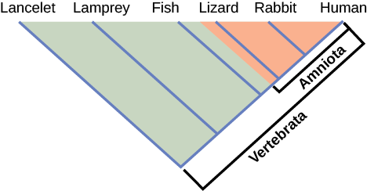
Figure 12.9 a phylogeny based on cladistics
Lizards, rabbits, and humans all descend from a common ancestor in which the amniotic egg evolved. Thus, lizards, rabbits, and humans all belong to the clade Amniota. Vertebrata is a larger clade that also includes fish and lamprey.
This OpenStax ancillary resource is © Rice University under a CC-BY 4.0 International license; it may be reproduced or modified but must be attributed to OpenStax, Rice University and any changes must be noted. Any images credited to other sources are similarly available for reproduction, but must be attributed to their sources.

Slide 28
Building phylogenetic trees 2 OF 3 (12.2)
Cladistics relies on 3 assumptions:
Living things are related by descent from a common ancestor
Speciation occurs by splits of one species into two
Traits change enough over time to be considered to be in a different state and one can identify the direction of change for a state
If a characteristic is found in all members of a group, it is called a shared ancestral character. These are not useful in cladistics.
If a characteristic is shared only by a certain group of organisms (only some of the organisms), it is called a shared derived character.
Shared derived characters have changed some during descent
Only shared derived characters should be used in cladistics
For example, the amniotic egg in Figure 12.9 is derived because only the lizard, rabbit and human have it, and are thus more closely related.

Slide 29
Building phylogenetic trees 3 OF 3 (12.2)
Usually computers generate phylogenetic trees using cladistics.
It there is more than one way to construct the tree based on the data, the principle of maximum parsimony is used.
Maximum parsimony means that the simplest, most obvious way with the least number of steps is used to construct the tree.
Concept in Action
Go to the website below to learn how maximum parsimony is used to create phylogenetic trees.
http://openstaxcollege.org/l/parsimony2

Slide 30
Vocabulary
Analogous structure
Binomial nomenclature
Branch point
Clade
Cladistics
Domain
Kingdom
Maximum parsimony
Molecular systematics
Monophyletic group
Phylogenetic tree
Phylogeny
Rooted
Shared ancestral character
Shared derived character
Sister taxa
Species
Systematics
Taxon
Taxonomy

